Slide 1
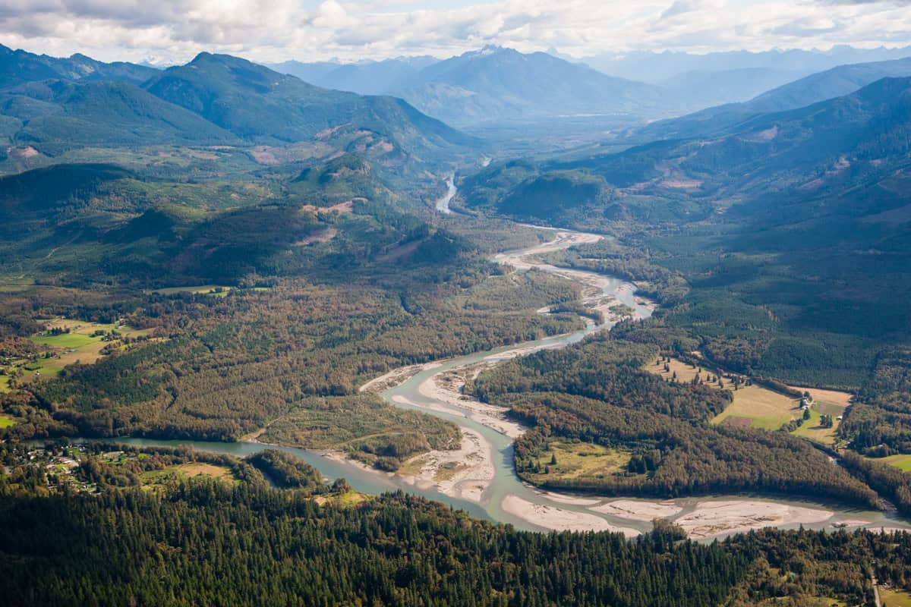

Flood Ready Hamilton
Flood Preparedness Training for the Town of Hamilton
Presented by: My freedom living, Forterra NW, Town of Hamilton, wa State dept. of ecology
Date & location: September 6th, 2025|hamilton fire Hall Building 951 Pettit St. Hamilton, WA 98255
Notes:
Welcoming Remarks:
Welcome everyone to the Town of Hamilton Flood Preparedness Training.
This training is a collaborative effort between the Town of Hamilton, Skagit County, Forterra, WA Department of Ecology, and My Freedom Living.
Our goal is to equip Hamilton residents with the knowledge and tools to prepare for, respond to, and recover from flooding events.
This training is for homeowners, renters, seniors, and all community members interested in safeguarding their families and property.
Your Presenters for this presentation consist of Barbara Prine Environmental Engineer My Freedom Living, Erika Porter SME My Freedom Living, Julie Currier Forterra NW, Rachel Valdez Forterra NW, Hamilton Fire Captain, Si Adams Public Works, Kym Eldridge Town Clerk.

Slide 2
Parking Information for Training Day
No Parking at Janicki Fuel Station | Please arrange alternate parking before arrival | Street parking on Maple St. & Petit St. (observe signage)
Recommended parking areas: | Hamilton Town Hall lot (if space available) | Allow extra time for parking and walking to venue
Notes:
Parking for the Flood Training day. There is plenty of parking at 951 Pettit Street where the training will be held.
There is no Parking at Janicki Fuel Station. There will be absolutely no parking allowed at Janicki Fuel Station this area must remain clear at all times. Parking on training day will be strictly enforced to ensure access for emergency vehicles and local businesses.
Participants are encouraged to plan ahead and use the Hamilton Town Hall lot, street parking along Maple Street and Petit Street (at 951 Pettit Street). where permitted.
We recommend arriving early to secure a space and allow time to walk to the Hamilton Fire Hall. If you require accessibility accommodations, please contact the Town Clerk in advance so arrangements can be made.

Slide 3
Welcome to Flood Ready Hamilton
Overview of training goals
Collaborative effort: Town of Hamilton, Forterra NW, WA State Dept. of Ecology, My Freedom Living
Target Audience: Homeowners, Renters, Seniors, New Residents, and Caregivers
Notes:
Main Talking Points:
This training is for homeowners, renters, seniors, new residents, individuals with access and functional needs, and those supporting others during disasters.
This training aligns with WA Department of Ecology’s Floodplain Management goals and is funded through a collaborative effort with Forterra NW.
Our target audience includes homeowners, renters, seniors, new residents, individuals with access and functional needs, and those supporting others during disasters.

Slide 4

Why Flood Training Matters
Supports Hamilton’s emergency planning and resilience
Flooding = #1 declared disaster in the U.S.
Hamilton is uniquely vulnerable
Notes:
Talking Points:
This session supports Hamilton's broader emergency planning and community resilience goals.
Flooding is the #1 declared disaster in the U.S. according to FEMA.
Skagit County experiences regular flooding and Hamilton is uniquely vulnerable due to its levee limitations.
Your presence here today helps make our town stronger, safer, and better prepared.
With this we will be going into the Hamilton Flood History & Risk

Slide 5
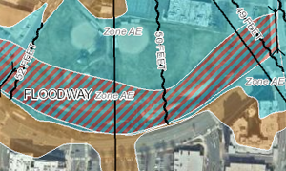
What is a Floodplain?
Definition of Floodplains and SFHAs:
A floodplain is the land adjacent to a river or stream that is susceptible to flooding. Special Flood Hazard Areas (SFHAs) are mapped by FEMA and represent areas with a 1% or higher annual chance of flooding (FEMA.gov).
FEMA Mapping basics
https://msc.fema.gov/portal/home
Notes:
Talking Points:
Floodplains are critical to the environment—they absorb excess water, reduce flooding downstream, and provide rich habitats for wildlife.
However, they can pose significant risks to people and property if development occurs without flood planning.
SFHAs are areas identified by FEMA as having a 1% or higher chance of flooding each year.
This is often called the “100-year flood” zone, though flooding can (and does) occur more often.
SFHAs are the areas where flood insurance is mandatory for federally backed mortgages.
These zones are shown on FEMA Flood Insurance Rate Maps (FIRMs).
Flood Insurance Rate Maps (FIRMs) are the main tool FEMA uses to communicate flood risk.
They show flood zone boundaries, base flood elevations, and other data.
Maps are updated periodically to reflect changes in land use, weather patterns, and hydrology.

Slide 6
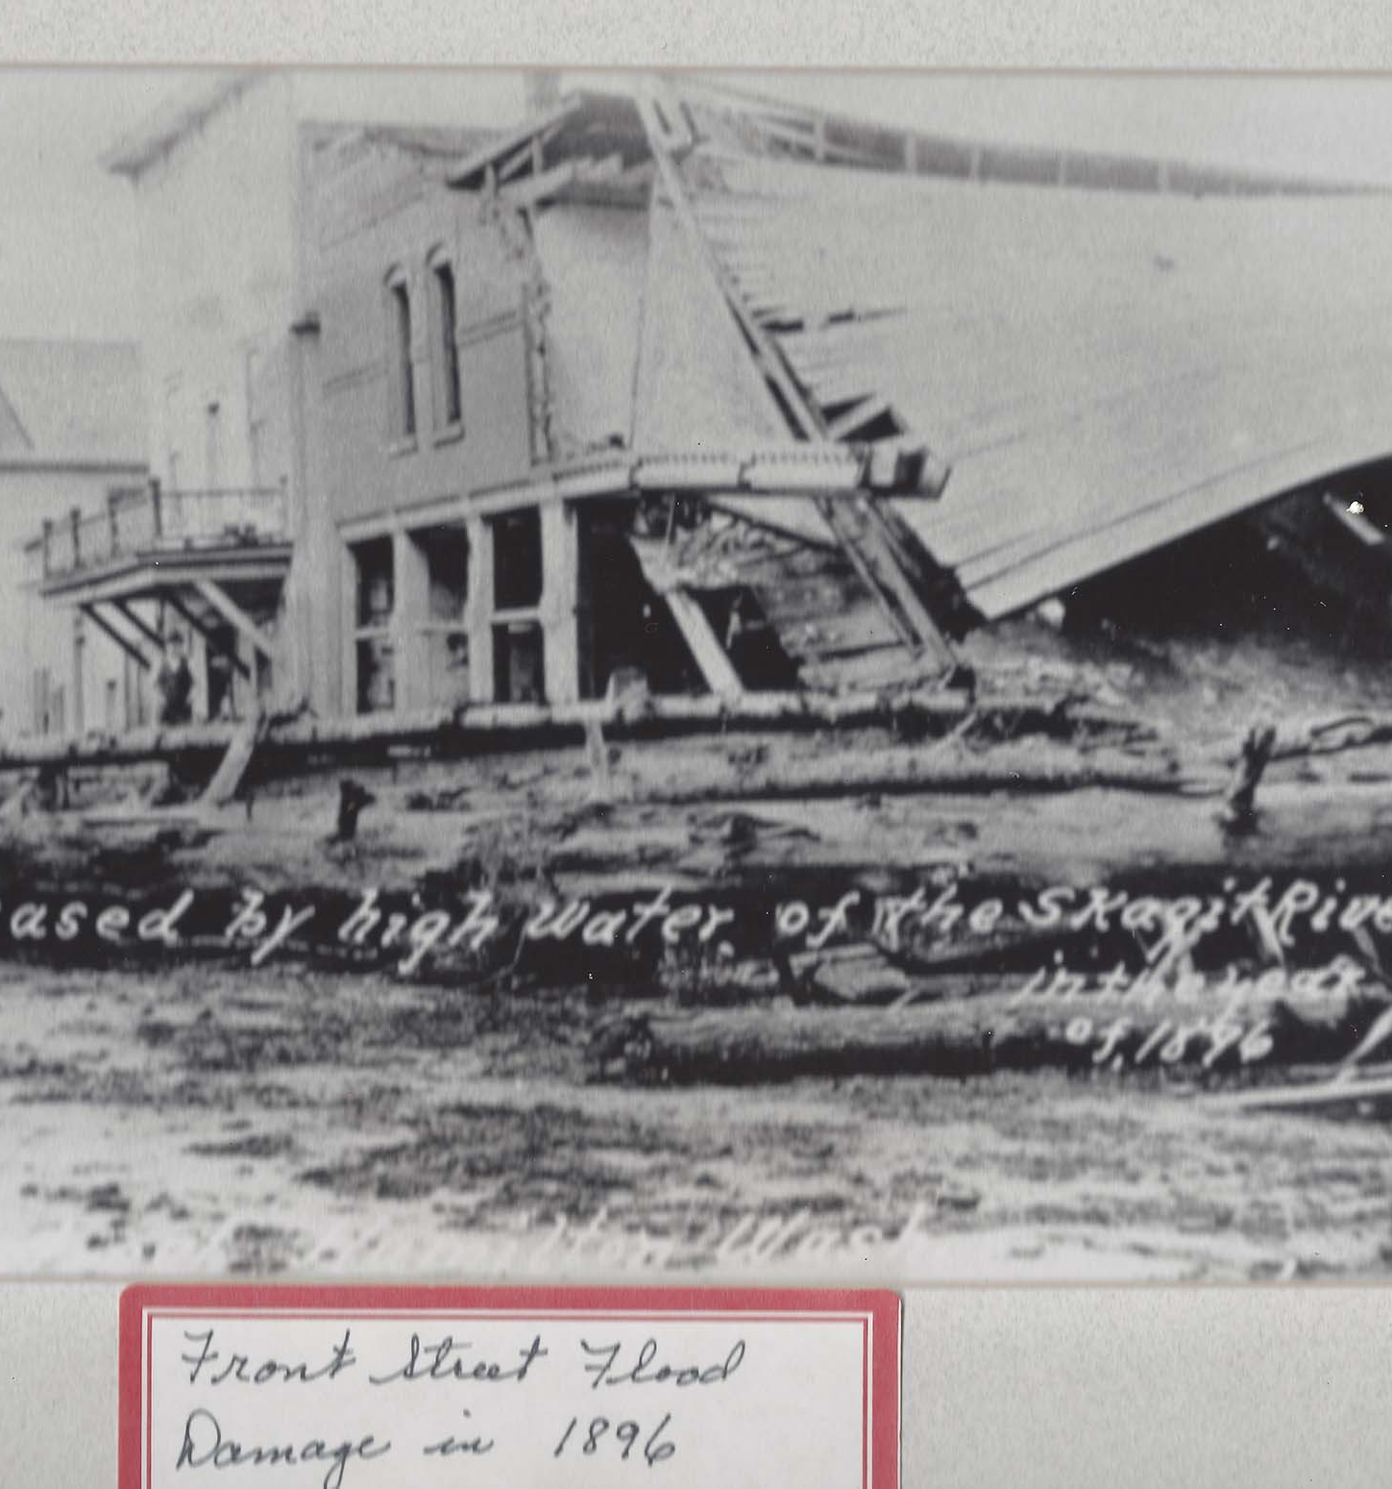
Skagit River Context
3rd largest river on the west coast
Hamilton’s location and historic Flooding
Notes:
Talking Points:
The Skagit is the third largest river on the west coast, after the Sacramento and Columbia. Hamilton has a long history of flooding, and the risk continues to grow with climate change.
The U.S. Army Corps of Engineers classifies the levee protecting Hamilton as non-accredited due to insufficient height and condition.
Climate change has led to stronger atmospheric rivers and higher snowpack melt, increasing flood frequency and intensity.
The Skagit River Basin supports salmon and tribal fishing rights, making flood management a critical issue for environmental justice and biodiversity.

Slide 7
Triggers of Local Flooding
Atmospheric rivers
Snowmelt
Wildfire
Dam/levee/dike failure
Earthquakes
Notes:
Climate change has led to stronger atmospheric rivers and higher snowpack melt, increasing flood frequency and intensity.
They can carry huge amounts of water vapor from the tropics to our region.
When they make landfall, they often release intense rain over several days.
These events can overwhelm drainage systems and rapidly raise river levels.
Wildfires burn away vegetation that normally absorbs rainfall, rain runs off the burned slopes much more quickly as well and this can cause flash flooding and dangerous debris flows.
Man-made structures like dams, levees, and dikes are built to hold back water.
If one fails—due to aging infrastructure, erosion, earthquakes, or overtopping—the sudden release of water can cause catastrophic flooding downstream.
Earthquakes can damage levees, dams, and dikes. They also can cause landslides that block rivers and liquefying soils, compromising flood defenses.

Slide 8
Types of Floods
Weather-related
Altered condition
Flash floods
Compound floods
Notes:
These floods are directly caused by weather events like heavy rain, hurricanes, or snowmelt.
Weather-related floods are often predictable based on forecasts and historical patterns.
These happen when land conditions have been changed by human activity or disasters, increasing flood risk.
Altered conditions reduce natural absorption and increase runoff, making flooding worse than it would have been naturally.
Sudden, fast-moving floods that can occur within minutes or hours after intense rainfall.
Flash floods are extremely dangerous because they happen with little warning and move quickly.
Occur when multiple flood drivers combine to worsen flooding.
Some examples of this would be Heavy rainfall + storm surge from a hurricane., High river flows + snowmelt at the same time,
Rain falling on saturated ground or frozen soil.
Compound flooding increases the depth, speed, and spread of floodwaters.

Slide 9
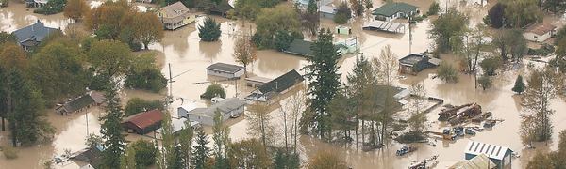
Historical Flood Events
Flood Years: 1990, 2003, 2017 and 2021
High water locations: Maple St., Petit St.
Notes:
The Skagit River is primarily fed by rainfall and snowmelt from the Cascades. Atmospheric river events often called “Pineapple Express” storms bring days of intense rain in fall and winter. These systems have repeatedly caused the Skagit River to overtop its banks and inundate Hamilton.
Floodwaters can rise quickly, often cutting off access to and from town. Hamilton sits in a FEMA-designated Special Flood Hazard Area with at least a 1% chance of major flooding every year.
Hamilton has been included in multiple federal disaster declarations due to severe flood events, most notably in 1990, 2003, 2017 and 2021.
In 2021, the levee failed and the Town had to cover emergency repairs on its own. That shows the local burden communities face when federal partners aren’t activated.

Slide 10
Levee Risk & Forecasting
Levee tops at 33.27 ft (Concrete gauge)
Non-accredited status (USACE)
Real-time gauge data
Notes:
Anything above the 33.27 ft levee will result in overtopping and inundation (Town of Hamilton).
When river levels approach this height, overtopping becomes a significant threat, putting homes, infrastructure, and residents at risk.
During major flood events, the river has risen to levels dangerously close to or exceeding this threshold
Hamilton is a Non-accredited Status (USACE), this means the levee does not meet the federal standards required to be considered reliable flood protection for regulatory purposes.
Because of this:
The area remains mapped in the Special Flood Hazard Area (SFHA).
Mandatory flood insurance applies for properties with federally backed mortgages.
Residents and the town cannot rely on the levee to fully protect them during a major flood.
The Skagit River near Hamilton has USGS and National Weather Service river gauges providing real-time readings.
These gauges are critical for:
Monitoring rising river levels during storms.
Issuing timely flood warnings.
Supporting evacuation decisions before the levee is overtopped or compromised.

Slide 11
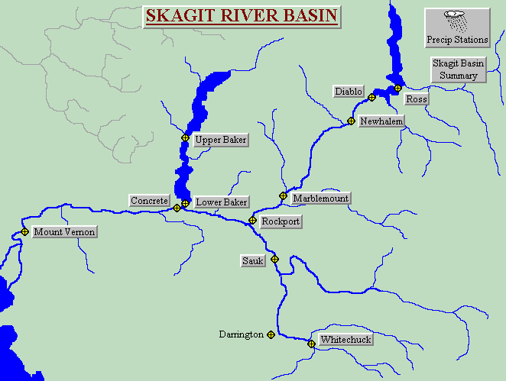
Skagit River Basin & Environmental Justice
Salmon habitat and Tribal rights
Climate Change = more intense floods
Notes:
The Skagit River is one of the most important salmon-producing rivers in the Puget Sound region, home to Chinook, coho, sockeye, chum, and pink salmon.
Flood control infrastructure—like levees, dams, and channelization—has damaged critical salmon spawning and rearing habitat over time.
Environmental justice demands that restoration and flood planning prioritize Tribal treaty rights to fish in their usual and accustomed places, and protection of endangered salmon.
Climate-driven floods disproportionately affect small towns and Tribal communities, many of which already face economic and infrastructure challenges.
These changes create larger, more damaging floods that threaten both human communities and natural ecosystems.
Environmental justice means ensuring that frontline communities—especially Tribes—are heard, respected, and prioritized in flood and land-use planning.
Solutions must balance public safety, habitat restoration, and Tribal sovereignty.
Now we will be going into Local Floodplain Regulations

Slide 12
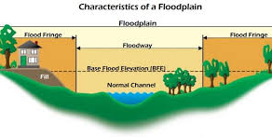
Floodplain Regulations & Overview
Ordinance: 330, 331, 352, and 232
Town of Hamilton Shoreline Master Program (SMP) – includes Flood Hazard Mitigation & Critical Areas Regulations
Complete the Pre-Application: Checklist available on the Town’s website before any project in the floodplain or floodway.
Notes:
The Town of Hamilton regulates flood-related development through both standalone ordinances and policies embedded in its Shoreline Master Program (SMP).
The direct codes you need to know are:
Ord. 330 – Floodway RV Standards – Sets standards for RV placement within the floodway.
Ord. 331 – Zoning for RV Uses & Limitations – Defines the zoning context for RV-related use in flood-prone areas.
In addition, the Shoreline Master Program—formally adopted via Ord. 352 and Ord. 232—includes broader regulations:
Ord. 352 – Flood Hazard Mitigation / Damage Prevention – Carries forward policies to minimize harm from flooding within shoreline and flood hazard areas.
Ord. 232 – Critical Areas Regulations & Procedures – Covers management of critical areas, including frequently flooded zones.
Together, these enact Hamilton’s local approach for flood risk reduction and regulatory oversight within the floodplain.
Pre-Application Process
Before starting any project in the floodplain or floodway, you must complete the Pre-Application Meeting Checklist from the Town’s website. This is a required first step.
Town staff will review your project idea as a pre-application meeting prior to all building permit submissions this is explained as rules apply (Ord. 330, Ord. 331, SMP), and tell you what documents you’ll need for a full permit application.
This step helps catch problems early and keeps your project moving smoothly.
Benefits of Compliance
Ongoing compliance protects community eligibility for federal flood insurance discounts.
It reduces the potential for post-disaster penalties or funding denials.
Protects public safety, critical infrastructure, and property values.

Slide 13
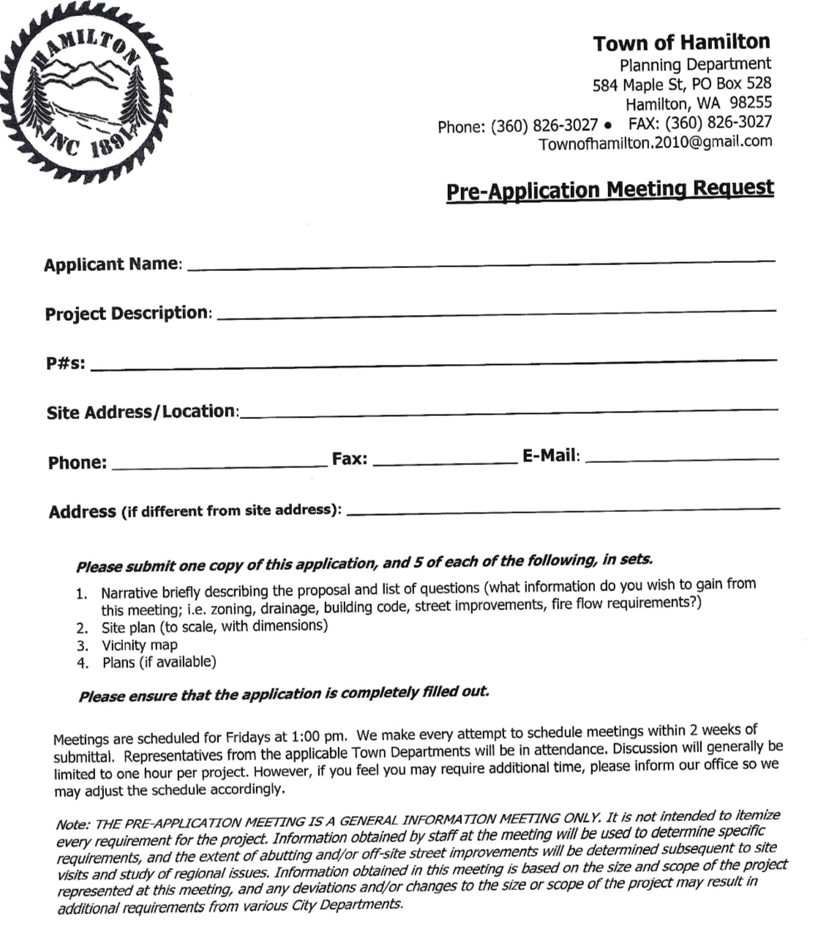
What Permits are Required?
Elevation requirements (BFE + Freeboard)
Elevation certificates are completed through a third party (town records)
Emergency sandbagging = no permit
Notes:
Hamilton’s rules for building in flood hazard areas are based on Town floodplain regulations.
Permit Requirement – If you plan to build, add fill dirt, or make major improvements in a flood zone, you must get a Floodplain Development Permit.
Build Higher – New and substantially improved buildings must be built above the Base Flood Elevation (BFE), plus extra height for safety (usually 1–2 feet). If building higher isn’t possible, flood proofing may be allowed.
Utilities & Lower Areas – Utilities must be protected from flooding. Any enclosed space below the BFE can only be used for parking, storage, or entry, and must have proper flood openings.
Neighborhood Projects – New subdivisions must be planned to reduce flood risk. Variances are rare and must meet strict rules.
Know Your Flood Level – The BFE in Hamilton changes depending on the property location. Check FEMA’s Flood Insurance Rate Map (FIRM) and get an Elevation Certificate from the Town to confirm your height.
Elevation Certificates – These are official FEMA forms completed by a licensed surveyor. They prove your building is high enough to meet flood rules and are required for permits, insurance, and compliance.
Online Permitting – You can apply for permits and upload documents like elevation certificates through the Skagit County online system or get help in person.
Emergency Sandbagging – From November to February, you can put out sandbags right away during flood threats—no permit is needed. This is a short-term defense, not a permanent solution.

Slide 14
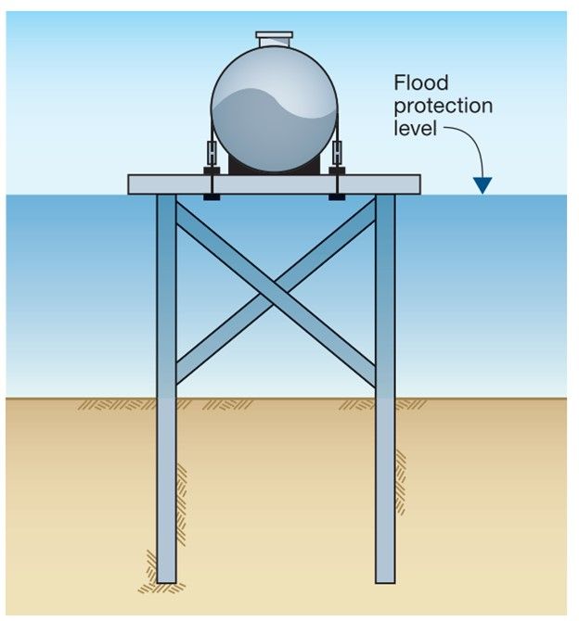
RV and utility Rules
RV’s: road ready, use permit, quick-disconnect fittings
Utilities: Anchoring, waterproofing
Notes:
Floodplain RVs must be kept road-ready and have the proper Town of Hamilton use permit to ensure safe, legal placement.
Quick-disconnect fittings on utilities allow for fast disconnection before flooding, reducing damage and hazards.
Utilities and RVs should be securely anchored and waterproofed to withstand floods and protect electrical and water systems.
Preparation:
All recreational vehicles must be currently licensed and road-ready.
Ordinance 330 – Floodway RV Standards: Requires RVs to meet road-ready requirements and be capable of quick relocation in the event of a flood.
Ordinance 331 – Zoning for RV Standards, Uses & Limitations: Specifies where RVs can be placed in flood zones and what conditions must be met.
Permits/tags can be purchased at Town Hall.
Monthly inspections by a Town Representative are conducted to check compliance and record violations as required by FEMA.
Evacuation:
Shut off all power at your main panel box.
Shut off propane at the tank.
When leaving town after evacuation, stop by or call the Hamilton Emergency Operations Center (EOC) at (360) 826-3027.
Provide a contact phone number so family and friends can find you.
If staying at your residence during a flood, notify the EOC at (360) 826-3027.

Slide 15
Junk Storage & Safety
One inoperable vehicle max unless fenced
Monthly town inspections
FEMA compliance monitoring
Notes:
Junk Storage Regulations:
Floodplain areas must be kept free of excessive junk and debris to prevent obstruction of floodwaters and reduce hazards during floods.
Proper storage minimizes risks of contamination and physical damage.
Inoperable Vehicles:
Only one inoperable vehicle is allowed per property in floodplain zones, unless it is stored inside a solid, fully fenced area that does not block or change the flow of water during a flood.
This limits clutter that can impede floodwaters or become hazardous debris.
Monthly Town Inspections:
Regular monthly inspections by town representatives help ensure compliance with floodplain regulations, including junk storage and vehicle restrictions.
These inspections identify and address potential safety issues proactively and they are documented for FEMA NFIP compliance.
FEMA Compliance Monitoring:
Ongoing monitoring ensures that local floodplain management practices meet FEMA standards, helping to protect public safety and maintain eligibility for federal flood insurance programs.
Floodplain violations include failure to disconnect RV utilities, blocking evacuation routes with junk or vehicles, improper junk storage, having multiple inoperable vehicles without fencing, and not maintaining RVs in a road-ready condition.
Noncompliance with permits also constitutes a violation.
These actions increase flood risks and can result in penalties.
Will be moving into the FEMA Flood Insurance & Personal Preparedness portion of the presentation
Junk storage and the keeping of more than one inoperable vehicle, including recreational vehicles, is prohibited outdoors unless in a solid fenced yard and not visible from the street.

Slide 16
Flood Insurance 101
NFIP basics: structure & contents
Renters can purchase contents-only
30-day waiting period
Notes:
National Flood Insurance Program (NFIP): Administered by FEMA; covers structural damage and contents.
Renters can obtain contents-only flood insurance.
30-day waiting period applies for new policies.

Slide 17
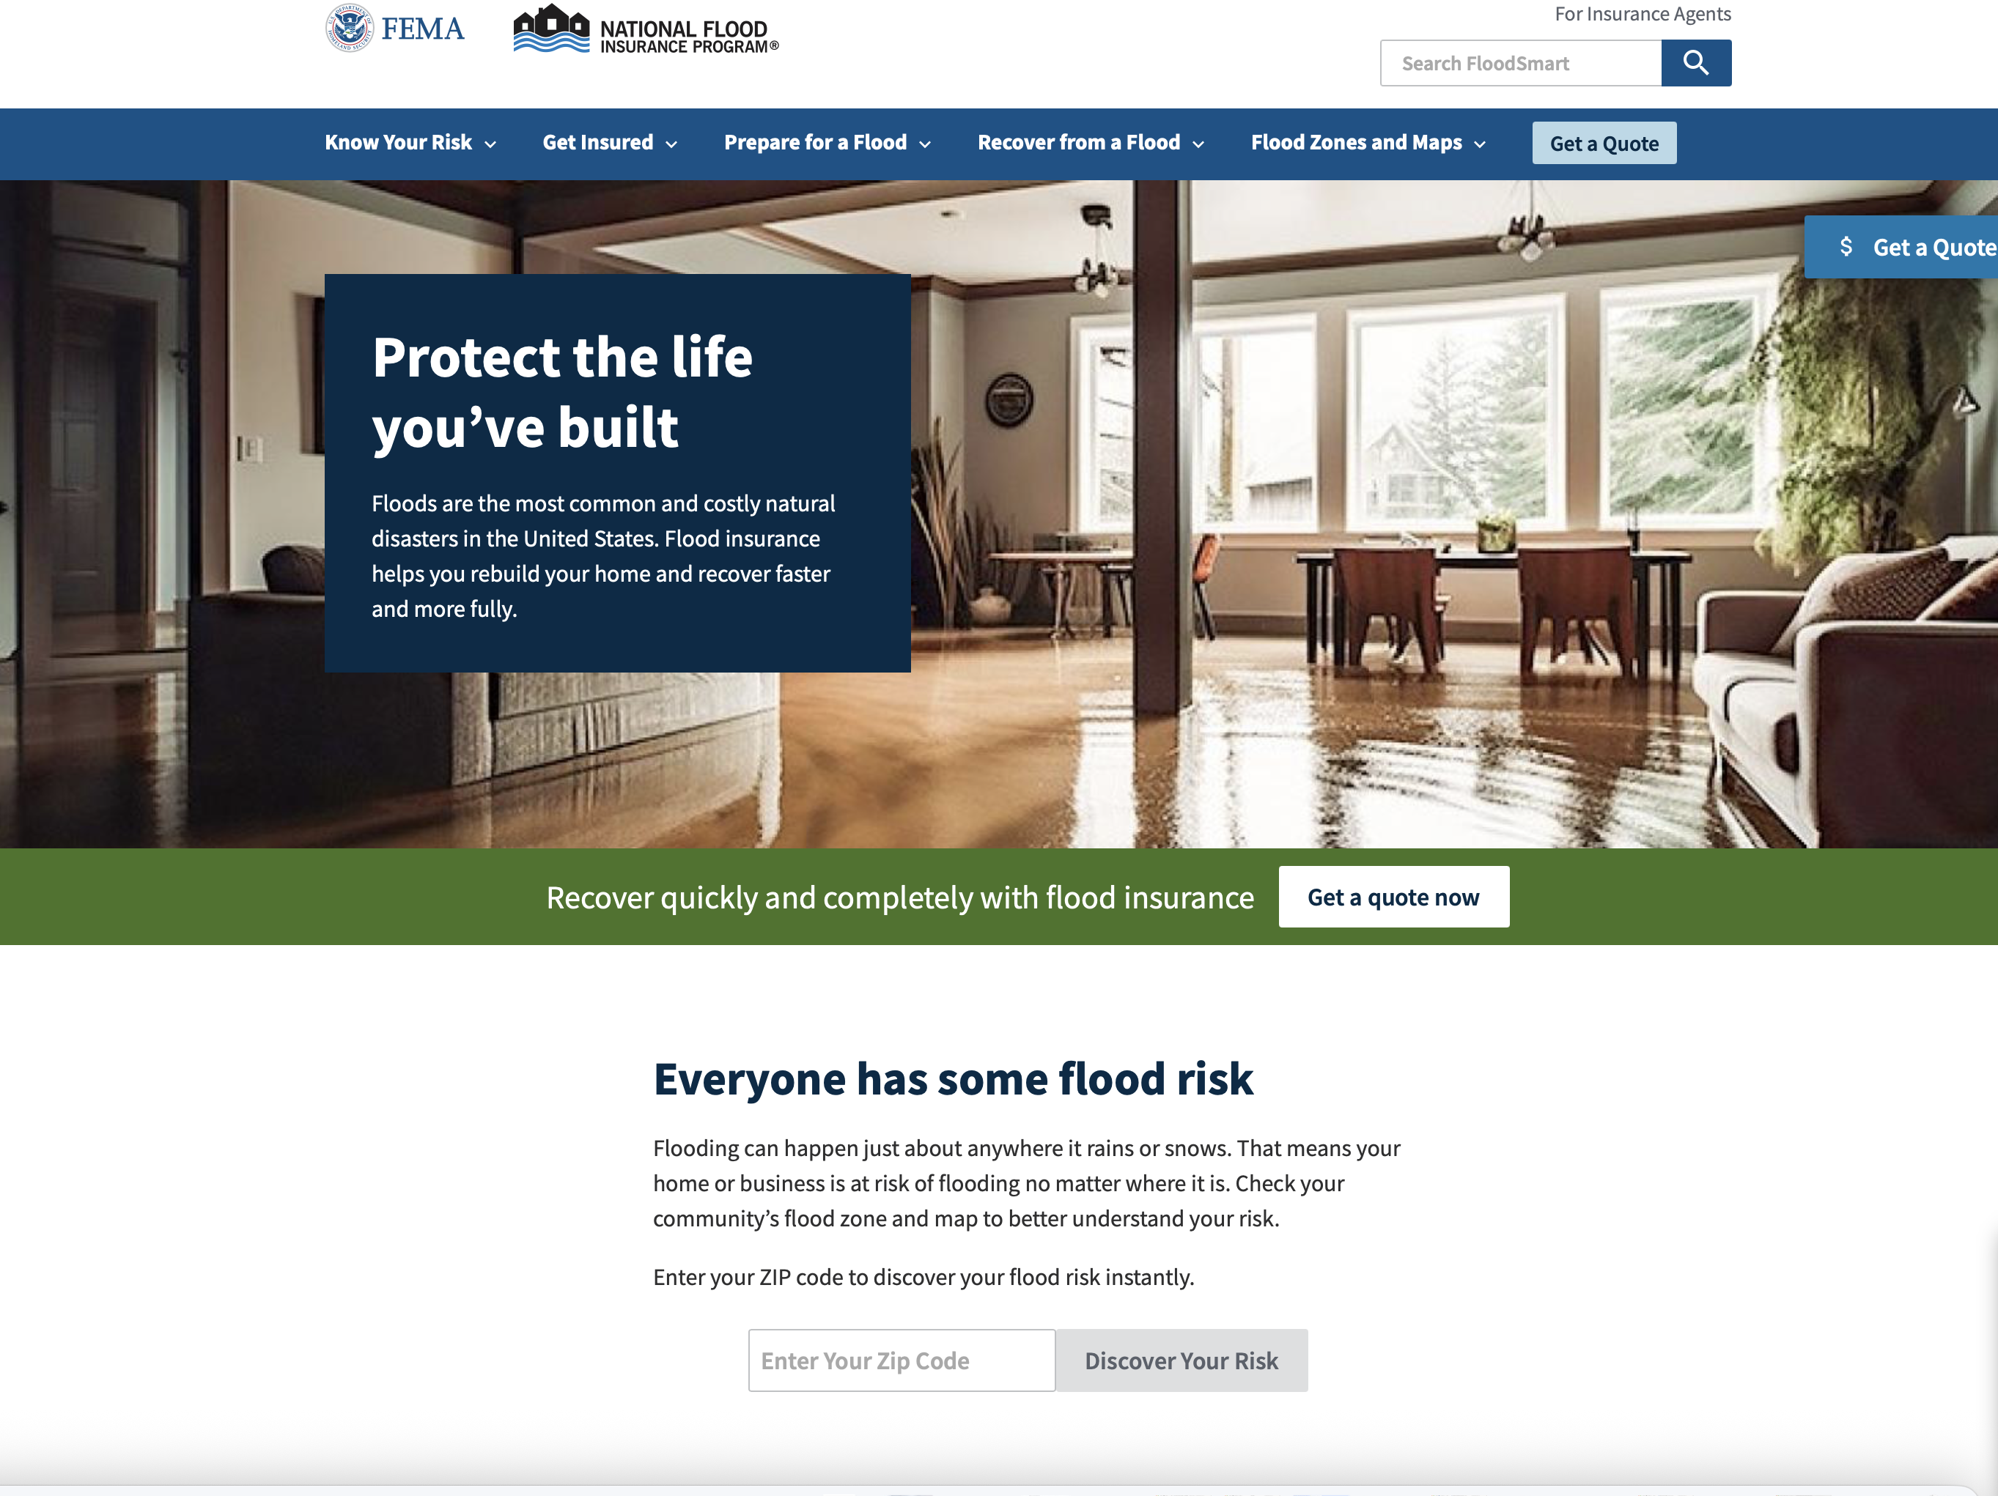
The Cost of Flooding
1 inch = up to 25k in damages
FloodSmart.gov calculator
Notes:
FEMA assistance following a declared disaster is not a substitute for flood insurance.
Average FEMA individual assistance grants are under $8,000, while flood insurance can cover far more.
Repetitive loss properties in Hamilton may be eligible for discounted premiums through the Community Rating System (CRS), if the town joins or participates in mitigation efforts.
Above is a screenshot of the floodsmart.gov calculator and we will show you how you can use this.

Slide 18

Emergency Kits
Water, Food, Flashlight, Meds, and Comfort items
Pet Supplies, Phone Chargers, and Documents
Notes:
Household Go bags should include the following:
1 gallon water/person/day
Non-perishable food, flashlight, batteries, first aid kit, sanitation supplies, medications
Comfort items (blankets, games, clothing)
Phone chargers, external battery banks
Copies of vital documents stored in a waterproof folder
In addition to household go-bags, every household should prepare an emergency car kit, especially if evacuation is required. This kit should include:
Flashlight and batteries
First aid kit
Blankets and warm clothing
Road flares or reflective triangles
Paper map and list of emergency contacts
Portable phone charger or backup battery
Snacks and bottled water
Snow chains or traction tools (in colder seasons)
Extra medication and hygiene items
For those with pets, have a plan in place, including food, crates, ID tags, and copies of vaccination records.
The Town of Hamilton does not have the capacity to provide animal shelter or evacuation services during flood events.

Slide 19
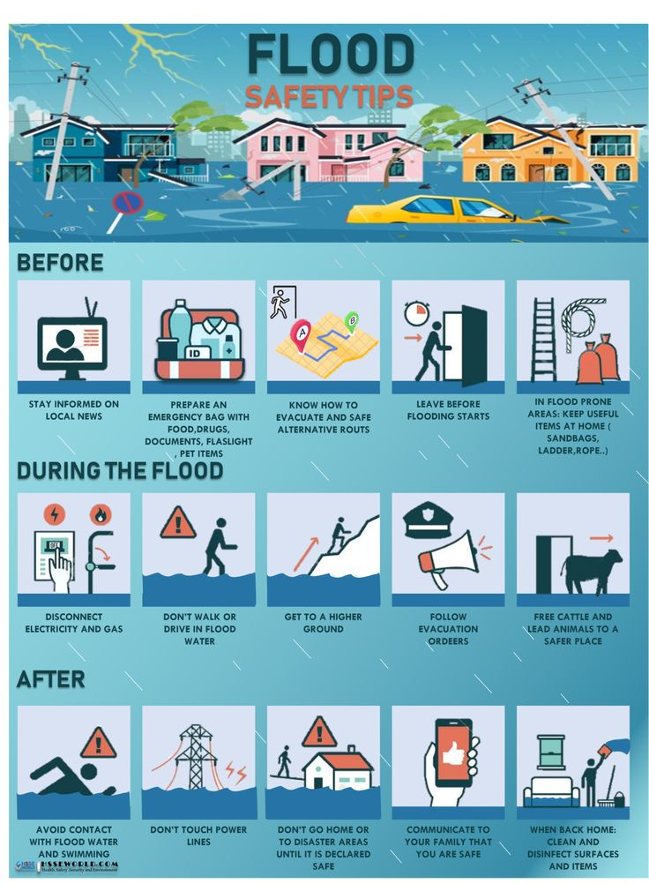
Family Preparedness Plans
Communication Plans
Plans for kids, pets, and mobility-limited
Shutoffs, evacuation alerts
Notes:
Create a communication plan
Plan for pets, children, seniors, and people with disabilities
Build emergency kits for home and car
Know utility shutoff procedures
Evacuate when advised
Ensure accessibility and backup plans for disabled or elderly household members
Consider purchasing a NOAA Weather Radio with alert tone capability and extra batteries.
Households with medical needs should pre-register with local emergency management for priority evacuation.

Slide 20
Siren Systems & Evacuation
ALERT = Flood Watch 1-minute siren
1
PREPARE = Prepare to Evacuate: 1-min siren → 30-sec pause → 1-min siren
2
EVACUATE = Evacuate Immediately: 1-min siren → 30-sec pause → 1-min siren (repeat)
3
Contact Emergency Operations C (EOC) located at Fire Hall Building (address) if evacuating or sheltering
4
Notes:
Follow siren system:
1-minute = ALERT
2-minute = PREPARE
3-minute = EVACUATE
Shut off power and propane
Notify Fire Dept if evacuating or sheltering in place
During any of these steps you should be gathering all go bags and preparing to leave or stay in place with these essential items previously discussed
The next section we will be moving into is the Community Actions & Resources
There will be absolutely no parking allowed at Janicki Fuel Station this area must remain clear at all times durning an Evacuation.

Slide 21
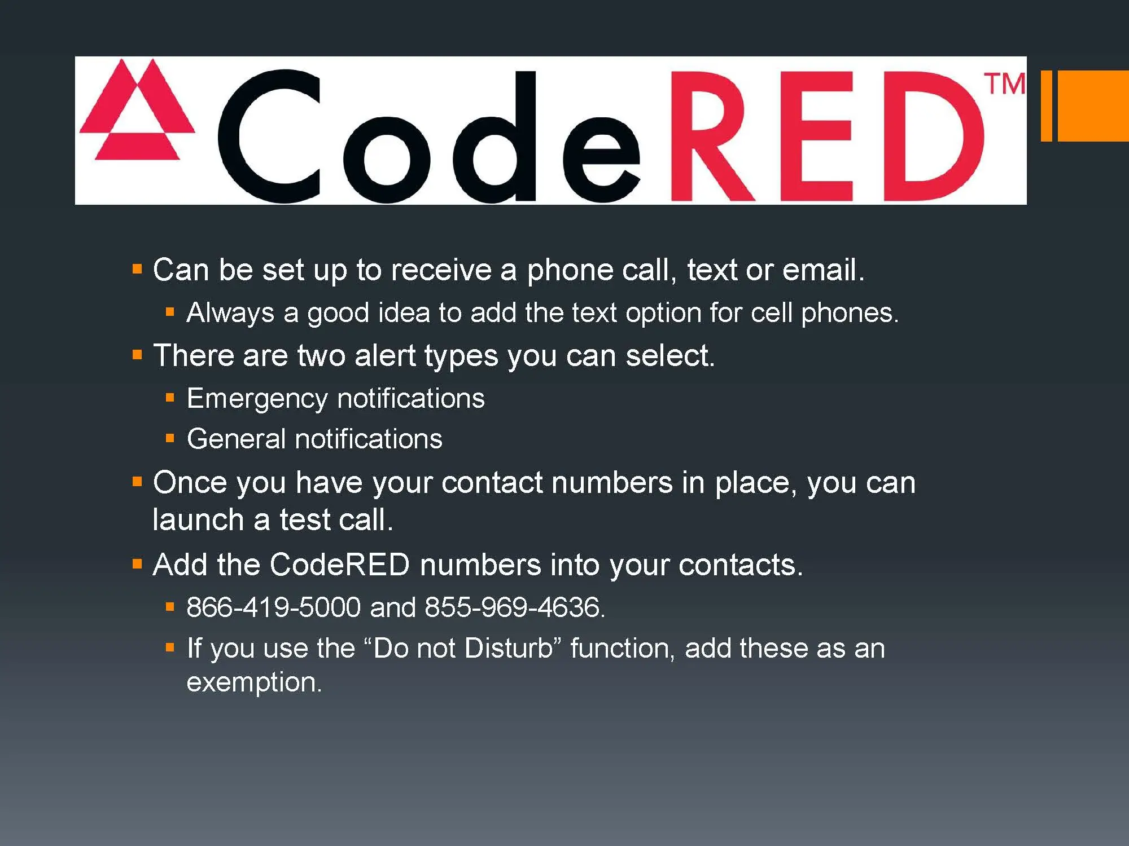
CodeRED & Alerts
How to sign up
Town Contact chain: Town Clerk>Skagit DEM
Disclosure: Emergency services for the Town of Hamilton are dispatched through Skagit County Fire District 8, which handles all 911 calls and emergency responses for the area.
Notes:
Talking Points:
Steps for enrolling in CodeRED (visual demo optional)
Community alerts are issued via CodeRED, Facebook, and town-wide sirens. The siren system is as follows:
Flood Alert – 1-minute siren: potential flooding
Prepare to Evacuate – 1-minute siren, 30-second pause, 1-minute siren: lower town areas may see flooding
Evacuate Immediately – 1-minute siren, 30-second pause, 1-minute siren, repeat: leave residence, expect 3–5 days until reentry
Skagit County Talking Point Prompts (County-led section)
Town’s flood contact flowchart: Town Clerk > County DEM
The Town of Hamilton no longer has their own Fire Department. People opting to stay in place during a flood would contact the Clerk. Then the Clerk would notify Skagit County District 8 Fire Protection to alert them.
The Town is also working to add a Flood Awareness link to its website. Printed copies of flood education materials will be available during training.

Slide 22
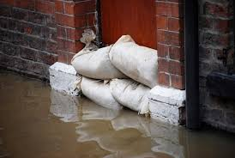

Resources & Contacts
Resources:
https://www.skagitcounty.net/flood
https://www.skagitcounty.net/Departments/EmergencyManagement/
Flyer Distribution plan:
Inserts in July/August utility bills
Posted on Facebook: "If You Live in Hamilton WA"
Contacts:
Town Hall: 360-826-3027
Hamilton Emergency Operations Center (EOC): 360.826.3027
Skagit County Emergency Management: (360) 428-3250
River Level Hotline: (360) 419-3245
Sandbag points
Printed Flyers and flood materials available
Notes:
https://www.skagitcounty.net/flood
https://www.skagitcounty.net/Departments/EmergencyManagement/
The Town is also working to add a Flood Awareness link to its website. Printed copies of flood education materials will be available during training.
Assistance available for mobility-limited households
Community Sandbag Distribution and Drop Points
Ensure you have an Emergency contact list readily available; here are a few contacts you should include on that list:
Town Hall: 360-826-3027
Hamilton Emergency Operations Center (EOC): (360) 826-3983
Skagit County Emergency Management: (360) 428-3250
River Level Hotline: (360) 419-3245
Our next portion focuses on the Voluntary Buyout Program

Slide 23
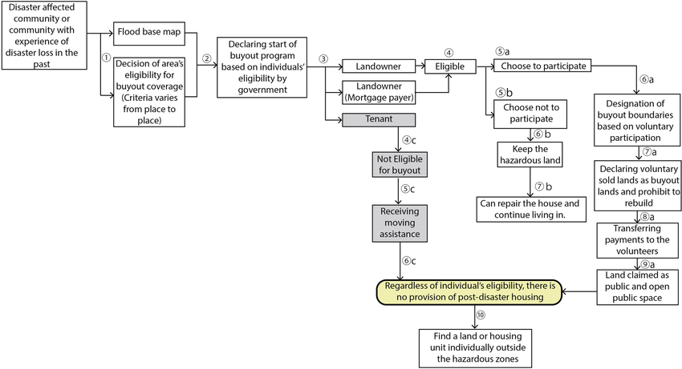
What is the Buyout Program?
Federally and State funded, voluntary
Grant program funded until June 2027 (property owners have until then to participate in a buyout under this grant)
Notes:
Federally supported option for property owners in high-risk flood areas to sell land back for removal from development.
Parcels bought out throug WA State funds are permanently deed-restricted and cannot be redeveloped.
Participation is 100% voluntary and does not affect eligibility for other disaster aid.
Some Hamilton properties have been previously identified as repetitive loss sites. If you're unsure about your eligibility, speak with Julie Currier Forterra at Info@forterra.org or Town Hall to schedule a review.
Washington success story examples of successful buyout projects will be provided at the training.

Slide 24
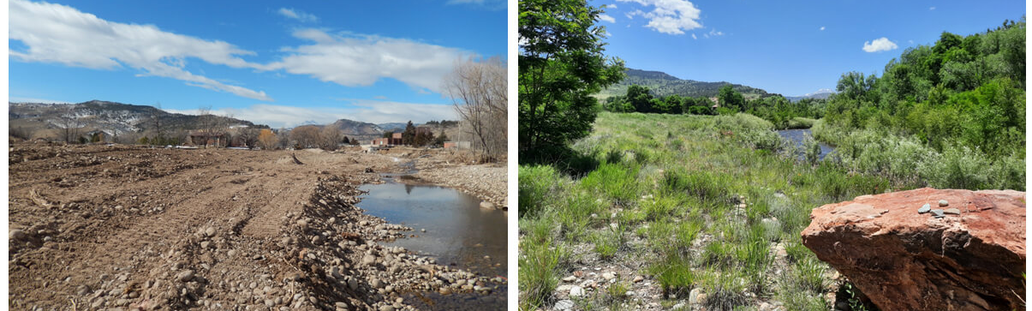
What Happens to the Land?
Deed restrictions = no future development
Open space, native vegetation
WA Ecology’s Buyout StoryMap https://apps.ecology.wa.gov/coastalatlas/wc/StoryMap.html?id=beta
Notes:
Converted to open space or natural area
No future development permitted
Land is often restored to native vegetation or used as passive open space, such as floodplain parks or buffer zones.
The WA Ecology StoryMap is a visual tool that shows real-life examples of how buyout land is restored. It highlights flood-prone neighborhoods before buyouts and then the same areas transformed into open fields, wetlands, and parks.
It helps property owners see the long-term benefits not just reduced flood risk, but also more natural floodplains, improved habitat, and added community spaces.
The StoryMap emphasizes that these lands are never redeveloped; instead, they become permanent open space that protects both people and the environment.

Slide 25
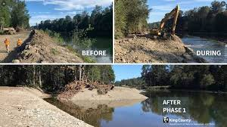
How to Get Started
Contact Town Hall 360-826-3027
Contact Tim DeVries – Skagit County Building Official & Floodplain Manager 📞 (360) 416-1300 ✉️ planning@co.skagit.wa.us
Contact Forterra Info@Forterra.org
Application>Appraisal>Site Visit> Closing
WA success stories before/after photos
Notes:
Contact Town Hall: 360-826-3027 or Skagit County Floodplain Manager
If you have questions about floodplain rules, permits, or building requirements in Hamilton, your point of contact is the Skagit County Floodplain Manager—Tim DeVries, who also serves as the County’s Building Official. He’s responsible for handling compliance with Skagit County’s flood damage prevention code (SCC 14.34) and works closely with FEMA standards.
Review case studies from Washington State
Documentation: Application, appraisal, site visit, closing
This leads us into a Q & A and then a Community Scenario
Contact Info: • Name: Tim DeVries, Building Official & Floodplain Manager, Skagit County • Office: Skagit County Planning & Development Services • Phone: (360) 416‑1300 (County Building Department main line) • Email: You can reach the department generally via planning@co.skagit.wa.us or find direct staff contact on their official site.

Slide 26
Q&A Prompt Slide
Example questions:
Do you know your Flood zone?
Do you have a Flood Insurance Policy?
What’s in your go-bag?
Are you signed up for CodeRED Alerts?
What would you take with you in an evacuation?

Slide 27
48-Hour Flood Scenario
You hear the 2-minute siren
What do you do?
Where do you go?
What do you take?
Notes:
You hear the 2-minute siren alert. Skagit is projected to rise past 33.27’.
You have a pet, a relative with mobility issues, and a recreational trailer.
What do you do?
Where do you go?
What do you take?
Introduce map and evacuation routes: Pettit Street, Maple St, Medford Road as high-ground options.
Small group activity: Identify gaps in your home’s plan. Present out key takeaways.

Slide 28
Scenario Activity- Map & Gaps
Use evacuation Map
Plan for pet, trailer, mobility-limited relative
Fill out worksheet
Worksheets are available at the handout table
Notes:
Participants are encouraged to fill out a flood preparedness planning worksheet.
This worksheet will help you:
• Identify important contacts
• List items to take during evacuation
• Note shelter-in-place vs. evacuate decisions
• Plan for pets, medications, and power outages
Worksheets are available at the handout table or via QR code.

Slide 29
Wrap-Up & Reminders
Before You Leave Today
Sign the attendance sheet and complete the post-training survey
Pick up the printed flood preparedness handout
Access the presentation & post-training survey (link will be posted on the Town of Hamilton website)
Note any questions for follow-up

Slide 30
Thanks & Acknowledgements
This training is brought to you by:
Si Adams, Hamilton Public Works
Kym Eldridge, Town Clerk
Julie Currier & Rachel Valdez, Forterra NW
Erika Porter & Barbara Prine, My Freedom Living (MFL)
WA State Dept. of Ecology
Notes:
The contacts for each entity need to be added

